Slide 1
Code Analysis And Artifact Registries
:- Pulkit Dhingra

Slide 2
What is Code Analysis?
Code analysis is a process of analyzing the source code to find the possible bugs and inconsistencies within the source code to prevent any malfunction and enhance the code quality and performance.

Slide 3
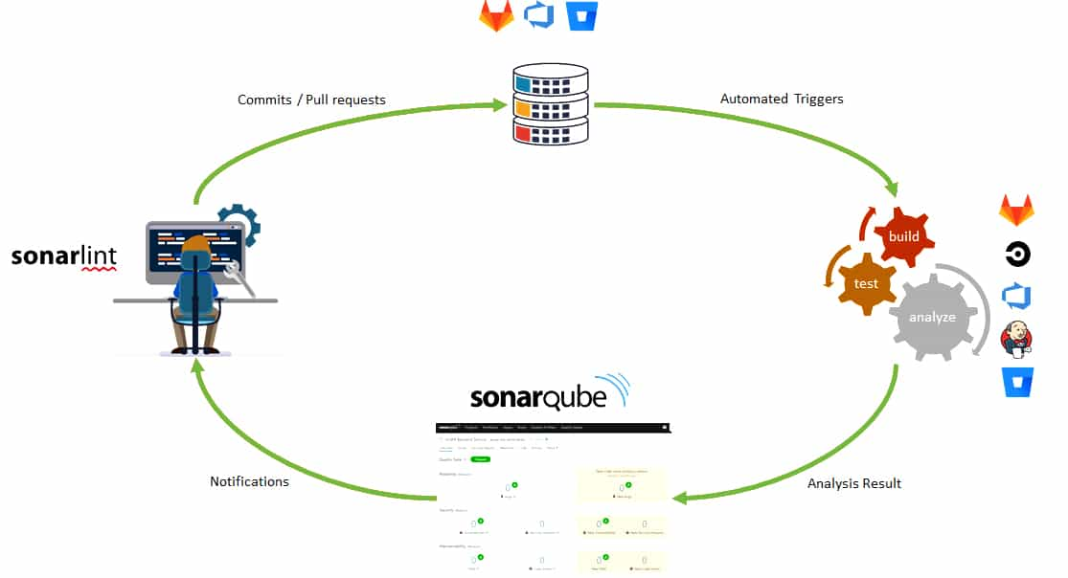
Sonarqube and SonarCloud
Sonarqube is a web-based tool that is used to analyze the quality of source code.
It uses a set of quality gates metrics that are inbuilt or can be custom defined for analysis.
A quality gate constitutes various quality profiles that are defined with various quality rules.

Slide 4
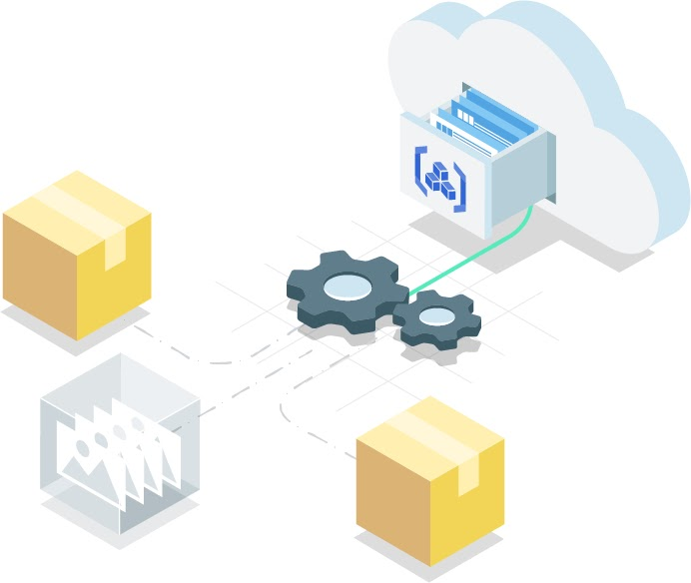
Artifact Registry
Just like a source code repository but for the build artifacts.
After the building process, the executable files and testing results are stored in an orderly versioned manner in an artifact registry.

Slide 5
DEMO

